Slide 1
Analysis of an autoencoder-based approach
BIWO - 08 Project Work
for determining the configuration
of embedded obstacles
Room 02-001, August-Bebel-Str. 30 // August 11, 2022
By Anvar Mohamed Aslam Sha

Slide 2
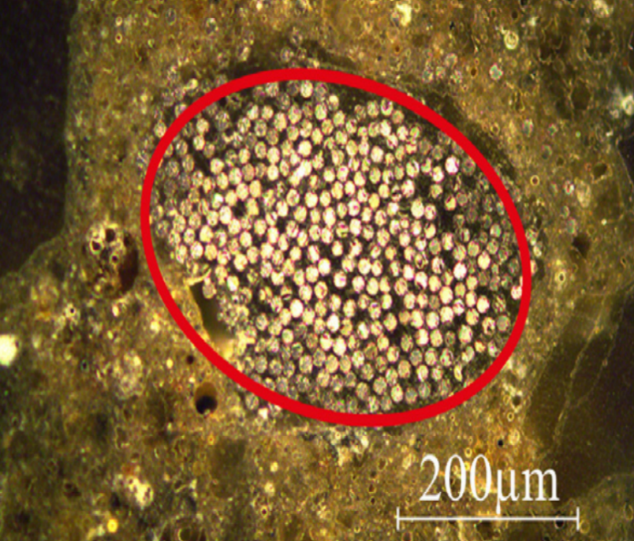
Motivation and goal
Major investigations had been conducted on the wave scattering behaviour of fibre-reinforced materials.
These fibers are built-up from numerous filaments of materials leading to a layered inner structure of the multi-filament yarns.
Stress waves can be focused within the regions of heterogeneity in composite material.
Aim is to implement an autoencoder-based approach to automatically determine the geometric parameters of composite materials.
The elliptical shape of the
multifilament yarn

Slide 3
Problem configuration

Slide 4
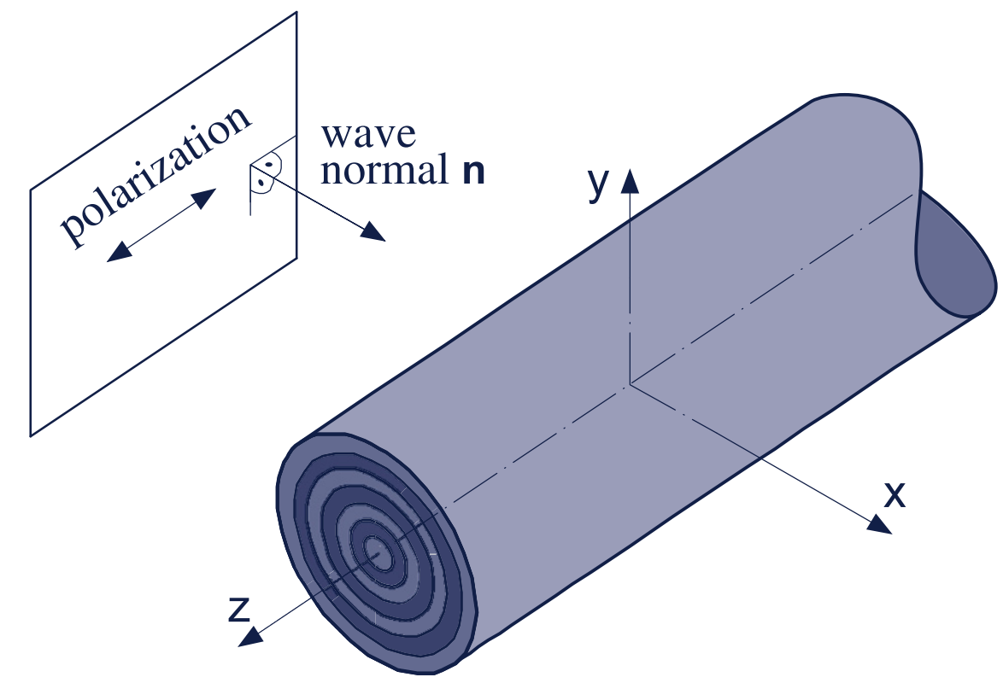
Problem configuration
Based on this specific inner structure of the yarns, a 2D-mechanical model was developed.
By projecting the complex 3D nature of the problem into a so-called plane of observation model was simplified.
The normal wave gets scattered by the obstacle.
The amplitude response spectra was determined by obstacle’s configuration.
In the experimental data dimensionless frequency stiffness, density, etc are the obstacle configuration and normalized amplitudes at various measuring points are wave response spectra.
Simplified 2D model

Slide 5
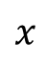
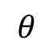
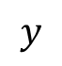
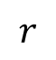
2D mechanical model
$$y$$
$$r$$
Amplitude measuring points
$$θ$$
$$x$$
Normal waves
Core
Scattered waves
Matrix
Interphase

Slide 6
Artificial neural networks

Slide 7
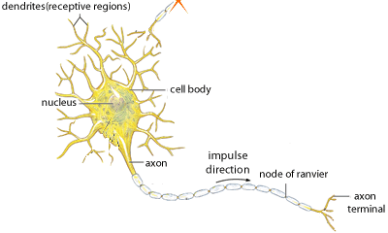
Artificial neural networks
The term neurons in neural networks, which is an analogy to the biological neurons, are presented as conceptual components for circuits that could perform computational tasks.
This idea of neuron processing was implemented on multilayer perceptron.
Dendrites
Cell body
Nucleus
Node
Axon
Axon
terminal

Slide 8
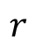
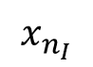
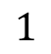
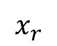
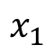
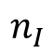
Two-layer multilayer perceptron
$$x_{1}$$
$$1$$
$$x_{r}$$
$$r$$
$$x_{n_{I}}$$
$$n_{I}$$
Input layer

Slide 9
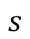

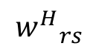
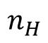
Two-layer multilayer perceptron
$$1$$
$$x_{1}$$
$$1$$
$$x_{r}$$
$${w^{H}}_{rs}$$
$$r$$
$$s$$
$$x_{n_{I}}$$
$$n_{I}$$
$$n_{H}$$
Input layer
Hidden layer

Slide 10
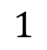
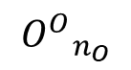
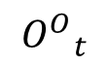
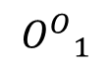
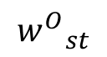
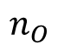
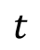
Two-layer multilayer perceptron
$$1$$
$$x_{1}$$
$$1$$
$$1$$
$${O^{O}}_{1}$$
$$x_{r}$$
$${w^{H}}_{rs}$$
$${w^{O}}_{st}$$
$$r$$
$$s$$
$$t$$
$${O^{O}}_{t}$$
$$x_{n_{I}}$$
$$n_{I}$$
$$n_{O}$$
$${O^{O}}_{n_{O}}$$
$$n_{H}$$
Input layer
Hidden layer
Output layer

Slide 11
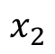
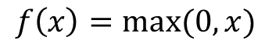
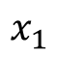
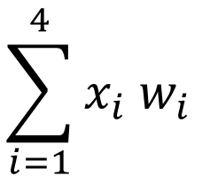
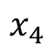
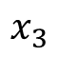
Neuron processing
$$x_{1}$$
Weights
$$f\left(x\right)=max⁡(0,x)$$
$$x_{2}$$
Output
$$\sum_{i=1}^{4}{x_{i}{ w}_{i}}$$
Input
o
$$x_{3}$$
Output neuron
ReLu
Weighted sum
Activation function
$$x_{4}$$
Input neurons

Slide 12
Computation graphs

Slide 13
Computation graph
Computational graphs are a type of graph that can be used to represent mathematical expressions.
In general, the computational graph is a directed graph that is used for expressing and evaluating mathematical expressions.
These can be used for two different types of calculations:
Forwardpass
Backwarpass

Slide 14
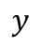
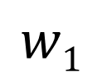
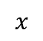
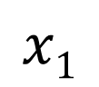
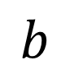
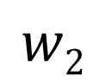
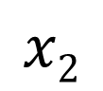
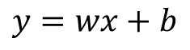
Computation graph
$$x1$$
$$y$$
$$w1$$
Two inputs
but only one sample
i.e. scalar inputs
$$x2$$
$$y=wx+b$$
$$w2$$
$$b$$
Bias
$$x$$

Slide 15
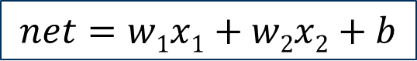
Computation graph
$$x1$$
$$w1$$
Weighted sum
$$x2$$
$$net=w1x1+w2x2+b$$
$$w2$$
$$b$$

Slide 16
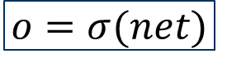
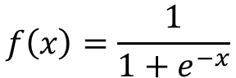
Computation graph
$$x1$$
$$w1$$
Sigmoid
activation function
Weighted sum
$$x2$$
$$net=w1x1+w2x2+b$$
$$o=σ(net)$$
$$w2$$
$$b$$
$$f\left(x\right)=\frac{1}{1+e^{−x}}$$

Slide 17

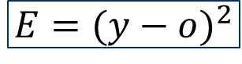
Forwardpass
$$x1$$
$$w1$$
Sigmoid
activation function
Weighted sum
Squared error
$$x2$$
$$net=w1x1+w2x2+b$$
$$o=σ(net)$$
$$E={(y−o)}^{2}$$
$$w2$$
Forward pass
$$b$$
For multiple samples mean of the
squared errors is optimized

Slide 18
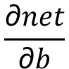
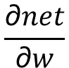
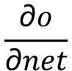
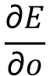
Backwardpass
$$x1$$
$$\frac{\text{∂}o}{\text{∂}net}$$
$$\frac{\text{∂}E}{\text{∂}o}$$
$$\frac{\text{∂}net}{\text{∂}b}$$
$$\frac{\text{∂}net}{\text{∂}w}$$
$$w1$$
Backward pass
$$x2$$
$$net=w1x1+w2x2+b$$
$$o=σ(net)$$
$$E={(y−o)}^{2}$$
$$w2$$
Forward pass
$$b$$

Slide 19
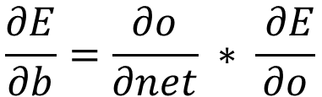
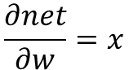
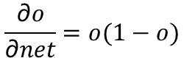
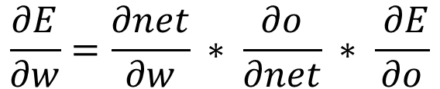
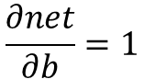

Backwardpass
$$x1$$
$$\frac{\text{∂}o}{\text{∂}net}$$
$$\frac{\text{∂}E}{\text{∂}o}$$
$$\frac{\text{∂}net}{\text{∂}b}$$
$$\frac{\text{∂}net}{\text{∂}w}$$
$$w1$$
Backward pass
$$x2$$
$$net=w1x1+w2x2+b$$
$$o=σ(net)$$
$$E={(y−o)}^{2}$$
$$w2$$
Forward pass
$$b$$
$$\frac{\text{∂}E}{\text{∂}w}=\frac{\text{∂}net}{\text{∂}w} ∗ \frac{\text{∂}o}{\text{∂}net} ∗ \frac{ \text{∂}E}{\text{∂}o}$$
$$\frac{\text{∂}E}{\text{∂}b}=\frac{\text{∂}o}{\text{∂}net} ∗ \frac{ \text{∂}E}{\text{∂}o}$$
$$\frac{\text{∂}E}{\text{∂}o}=\frac{{\text{∂}(y−o)}^{2}}{\text{∂}o}=−2(y−o)$$
$$\frac{\text{∂}o}{\text{∂}net}=o(1−o)$$
$$\frac{\text{∂}net}{\text{∂}w}=x$$
$$\frac{\text{∂}net}{\text{∂}b}=1$$

Slide 20






Gradient descent algorithm
Global minima
Gradient descent update rule
Local minima
$$w_{1} :=w_{1}− η\frac{\text{∂}E}{\text{∂}w_{1}}$$
$$E(w)$$
$$w_{2} :=w_{2}− η\frac{\text{∂}E}{\text{∂}w_{2}}$$
$$b ≔b− η\frac{\text{∂}E}{\text{∂}b}$$
Where, $η$ is the learning rate.
It controls the response of the updates.
One cycle of forward and backward pass
is called an epoch

Slide 21









Normalization
Large ranged inputs
Nominal ranged inputs
$$w_{2}$$
$$x_{1}≫x_{2}$$
$$w_{2}$$
$${0≤x}_{1}≤1$$
$${0≤x}_{2}≤1$$
$$E(w)$$
$$E(w)$$
$$x_{new} :=\frac{x−x_{min}}{x_{max}−x_{min}}$$
$$w_{1}$$
$$w_{1}$$

Slide 22
Convolutional neural networks

Slide 23
1D Convolution neural networks
Instead of directly passing the inputs to the input neurons of the multipayer perceptron, convolution is performed.
Convolutional neural networks or CNNs have three layer.
Covolutional layer:
Dot product of kernels and the input signal to create convolved 2D array.
Pooling layer:
Extracts max value from each sliding action.
Fully connected layer:
Converts convolved 2D array into a 1D array before feeding it into multilayer
perceptron.

Slide 24
Convolution layer
Input
3
7
6
1
4
5
1
3
4
6
x
x
x
Kernel
1
4
6
Calculates dot product of the input signal and kernel
+
Feature map
64
37
34
47
30
25
37
55
2D Array
1D Array

Slide 25
Convolution layer
Input
3
7
6
1
4
5
1
3
4
6
x
x
x
1
4
6
Sliding action of the kernel
Kernel
+
Feature map
64
37
34
47
30
25
37
55
2D Array
1D Array

Slide 26
Convolution layer
Input
3
7
6
1
4
5
1
3
4
6
x
x
x
Kernel
1
4
6
Kernel slides with a stride of 1 unit
+
Feature map
64
37
34
47
30
25
37
55
2D Array
1D Array

Slide 27
Convolution layer
Input
3
7
6
1
4
5
1
3
4
6
10x1
x
x
x
1
4
6
Kernel
3x1
+
Feature map
64
37
34
47
30
25
37
55
8x1
2D Array
1D Array

Slide 28
Convolution layer
"Same” padding
Input
0
3
7
6
1
4
5
1
3
4
6
0
x
x
x
Kernel
1
4
6
+
Feature map
54
64
37
34
47
30
25
37
55
28
2D Array
2D Array
1D Array

Slide 29
Convolution layer
"Same” padding
Input
0
3
7
6
1
4
5
1
3
4
6
0
x
x
x
Kernel
1
4
6
+
Feature map
54
64
37
34
47
30
25
37
55
28
2D Array
2D Array
1D Array

Slide 30
Convolution layer
Input
3
7
6
1
4
5
x
x
Kernel
1
4
+
Feature map
31
10
24
2D Array
1D Array

Slide 31
Convolution layer
Input
3
7
6
1
4
5
x
x
Kernel
1
4
Kernel slides with a stride of 2
+
Feature map
31
10
24
2D Array
1D Array

Slide 32
Convolution layer
Input
3
7
6
1
4
5
x
x
Kernel
1
4
+
Feature map
31
10
24
2D Array
1D Array

Slide 33

Convolution layer
Input
3
7
6
1
4
5
6x1
x
x
Kernel
1
4
$$Olength=\frac{Ilength−Klength}{Stride}+1$$
2x1
+
Feature map
31
10
24
3x1
2D Array
1D Array
Feature
maps

Slide 34

Max pooling
Input/
Feature
map
54
64
37
34
47
30
25
37
55
9x1
Max pool filter
54
64
37
3x1
Global pooling
64
47
55
3x1
$$Olength=\frac{Ilength−Klength}{Stride}+1$$

Slide 35
Max pooling
Input/
Feature
map
54
64
37
34
47
30
25
37
55
9x1
Max pool filter
34
47
30
3x1
Global pooling
64
47
55
3x1
$$Olength=\frac{Ilength−Klength}{Stride}+1$$

Slide 36
Max pooling
Input/
Feature
map
54
64
37
34
47
30
25
37
55
9x1
Max pool filter
25
37
55
3x1
Downsampling
Global pooling
64
47
55
3x1
$$Olength=\frac{Ilength−Klength}{Stride}+1$$

Slide 37
Fully connected layer
2D Array
Feature maps/
Global pooling
5 x 64

Slide 38
Fully connected layer
2D Array
Flattening
5 x 64

Slide 39
Fully connected layer
2D Array
1D Array
Flattening
5 x 64
Fully Connected Layer is simply, feed forward neural networks.
The input is flattened and then fed into the fully connected layer.
320 x 1

Slide 40





Machine learning model
Python 3.10
Keras
Tensorflow
Scikit-learn
Normalization
Training validation split
Nvidia
GTX 960m
CNN Model
80% of the input data
Is trained and remaining
Is kept for validation.
Matplotlib

Slide 41
Estimation of normalized amplitudes

Slide 42


Simplified training
The multi-output regression problem of estimating normalized amplitude at different measuring points is simplified to a 2D problem.
CNN model is trained on 1D input, dimensionless frequency to predict 1D output, amplitude.
Loss (MSE) is calculated at each epoch.

Slide 43
Simplified training

Slide 44
Simplified training

Slide 45


Simplified training
Even though the model was able to learn during the training, the results were still poor.
Predicted and target values of the normalized amplitude are compared by calculating the mean absolute percentage error.

Slide 46
Simplified training

Slide 47
Simplified training

Slide 48


Simplified training
For further analysis, the predicted and target amplitudes are plotted against the dimensionless frequency.

Slide 49
Simplified training

Slide 50
Simplified training
As observed, the approximated function
is unable to map the input appropriately.

Slide 51
Patchwise training
Dimensionless Frequency
1.4967
1.6633
1.8300
1.9873
1.4967
1.6633
1.8300
1.9873
For example
patch size
of 0 to 20
50.8840
50.9988
51.1655
51.3321
19.5935
19.6641
19.8308
19.9975

Slide 52
Patchwise training
Dimensionless frequency
1.4967
1.6633
1.8300
1.9873
Instead of simplifying the forward approach, multi-output regression is performed i.e. amplitude at multiple points are estimated simultaneously.
Number of learning parameters greatly reduced.
Less processing time.
19.5935
19.6641
19.8308
19.9975

Slide 53

Similarity analysis
Normalized Amplitudes
0. 75885
0. 75325
0. 74724
0. 82965
0. 82898
0. 83324
0. 90754
0. 87578
0. 90121
0. 91129
$$Percetage change=\frac{|Referenced −Compared|}{|Referenced|}$$
In conjunction to the patchwise training
similarity analysis is also performed for
Multi-output regression problem.

Slide 54
Similarity analysis
Normalized Amplitudes
0. 75885
0. 75325
0. 74724
0. 82965
0. 82898
0. 83324
0. 90754
0. 87578
0. 90121
0. 91129
0.74%

Slide 55
Similarity analysis
Normalized Amplitudes
0. 75885
0. 75325
0. 74724
0. 82965
0. 82898
0. 83324
0. 90754
0. 87578
0. 90121
0. 91129
1.52%

Slide 56
Similarity analysis
Normalized Amplitudes
0. 75885
0. 75325
0. 74724
0. 82965
0. 82898
0. 83324
0. 90754
0. 87578
0. 90121
0. 91129
20.08%

Slide 57
Similarity analysis
Normalized Amplitudes
0. 75885
0. 75325
0. 74724
0. 82965
0. 82898
0. 83324
0. 90754
0. 87578
0. 90121
0. 91129
0.79%

Slide 58
Similarity analysis
Normalized Amplitudes
0. 75885
0. 75325
0. 74724
0. 82965
0. 82898
0. 83324
0. 90754
0. 87578
0. 90121
0. 91129
10.14%

Slide 59
Similarity analysis
Normalized Amplitudes
0. 75885
0. 75325
0. 74724
0. 82965
0. 82898
0. 83324
0. 90754
0. 87578
0. 90121
0. 91129
20.98%
Samples with the least percentage
difference are removed from
the training set.

Slide 60

Patchwise training
Now the machine learning model is trained with 119 samples and patch size of dimensionless frequency in the range of 3 to 3.05.
Loss (MSE) is calculated at each epoch.

Slide 61


Simplified training
Predicted and target values of the normalized amplitude are compared by calculating the mean absolute percentage error.

Slide 62
Simplified training

Slide 63
Simplified training

Slide 64


Simplified training
For further analysis, the predicted and target amplitudes are plotted against the dimensionless frequency.

Slide 65
Simplified training

Slide 66
Simplified training
As observed, the model is able to produce
a good approximation of the function.

Slide 67
Estimation of obstacle configuration

Slide 68

Patchwise training
Now we estimate obstacle configuration from the normalized amplitudes.
The machine learning model is kept the same.
Loss (MSE) is calculated at each epoch.

Slide 69


Simplified training
Predicted and target values of the obstacle configuration $r1$ and $r2$, are compared by calculating the mean absolute percentage error.

Slide 70

Simplified training

Slide 71
Simplified training

Slide 72


Simplified training
For further analysis, the predicted and target configurations are plotted against the dimensionless frequency .

Slide 73
Simplified training

Slide 74
Simplified training
As observed, the model is able to produce
a good approximation of the function.

Slide 75
Conclusion
An already developed 2D-mechanical model which was based on the inner structure of the multi-filament was studied.
To determine the configuration of embedded obstacle from amplitude response spectra, an autoencoder-based approach was carried out using convolutional neural networks.
For further improvement of the machine learning model, two novel strategies were developed, patchwise training and similarity analysis.
Thus, a numerical method alternative to the analytical solution of the 2D-mechanical model was developed.

Slide 76
Thank you

